Slide 1
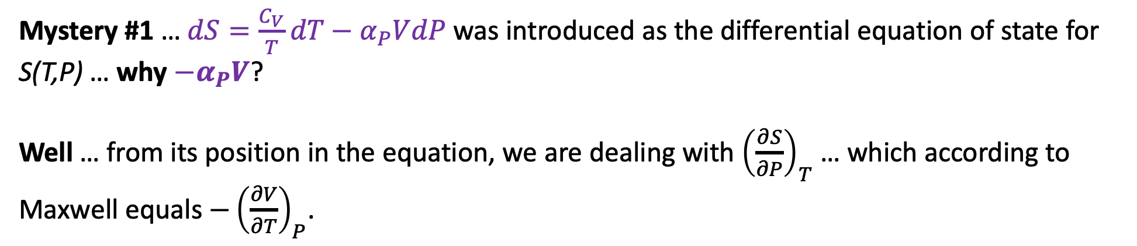
IV. Mysteries revealed
Mystery #1 … $dS=\frac{C_{V}}{T}dT−α_{P}VdP$ was introduced as the differential equation of state for S(T,P) … why $−α_{P}V$?
Well … from its position in the equation, we are dealing with ${\left(\frac{∂S}{∂P}\right)}_{T}$ … which according to Maxwell equals ${−\left(\frac{∂V}{∂T}\right)}_{P}$.
$${{\left(\frac{∂S}{∂P}\right)}_{T}=−\left(\frac{∂V}{∂T}\right)}_{P}=−\frac{V}{V}{ \left(\frac{∂V}{∂T}\right)}_{P}=−V\left[\frac{1}{V}{ \left(\frac{∂V}{∂T}\right)}_{P}\right]=−Vα_{P}$$

Slide 2
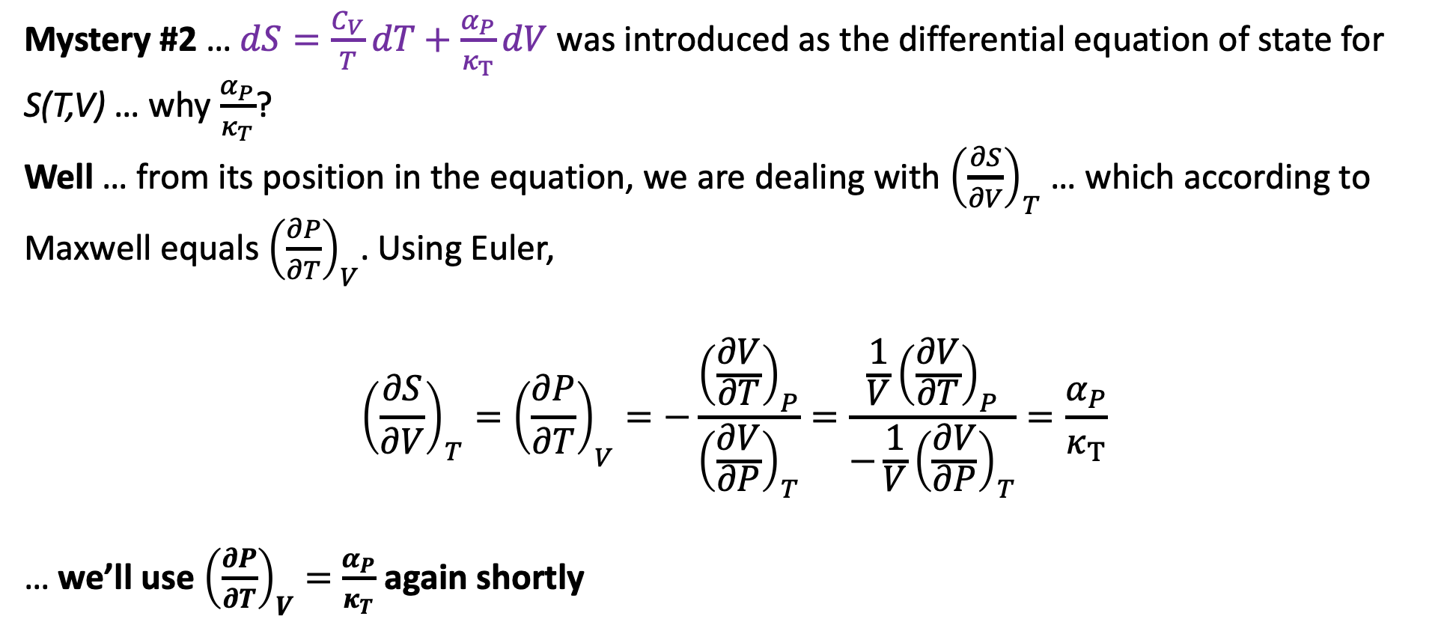
IV. Mysteries revealed
Mystery #2 … $dS=\frac{C_{V}}{T}dT+\frac{α_{P}}{κ_{T}}dV$ was introduced as the differential equation of state for S(T,V) … why $\frac{α_{P}}{κ_{T}}$?
Well … from its position in the equation, we are dealing with ${\left(\frac{∂S}{∂V}\right)}_{T}$ … which according to Maxwell equals ${\left(\frac{∂P}{∂T}\right)}_{V}$. Using Euler,
$${{\left(\frac{∂S}{∂V}\right)}_{T}=\left(\frac{∂P}{∂T}\right)}_{V}=−\frac{{\left(\frac{∂V}{∂T}\right)}_{P}}{{\left(\frac{∂V}{∂P}\right)}_{T}}=\frac{{\frac{1}{V}\left(\frac{∂V}{∂T}\right)}_{P}}{−\frac{1}{V}{\left(\frac{∂V}{∂P}\right)}_{T}}=\frac{α_{P}}{κ_{T}}$$
… we’ll use ${\left(\frac{∂P}{∂T}\right)}_{V}=$ $\frac{α_{P}}{κ_{T}}$ again shortly

